Slide 1
IBR, ICR, PAYE What the difference?
Presented by
Jon Potter, Nelnet
Sun Ow, Great Lakes
Jamal Collins, UC Berkeley School of Law

Slide 2
Agenda
•
•
What is the definition of IBR, ICR and PAYE?
What are the requirements to participate
the repayment plans?
How do the repayment plans compare?
in
•
•
What is my role in assisting students
choosing a repayment plan?
Examples of different repayments
Questions (and possibly answers)
in
•
•

Slide 3
Definitions
•
•
•
IBR
ICR PAY
Income Based Repayment Plan
Income-Contingent Repayment Plan
Pay as You Earn Repayment Plan

Slide 4
Two
IBR
Plans
•
Current IBR Plan – Effective 7/1/13
– Available to FFEL & Direct Loan
borrowers for both direct and FFEL loans
Final IBR Plan – Effective 7/1/14
•
–
Available to FFEL
for only the Direct
& Direct Loan borrowers
Loan program

Slide 5
Income-Based
Repayment
Plan
•
Currently both Direct Loan and FFEL
borrowers can use this repayment plan.
Graduate PLUS can use this repayment plan, but Parent PLUS cannot.
It cannot be used to repay defaulted student loans.
If the 10 year Standard Repayment Plan
has a higher monthly payment than the
IBR, student can qualify to use the plan.
•
•
•

Slide 6
Income-Contingent Repayment Plan
•
•
Available to Direct Loan borrowers only.
Graduate PLUS can use this repayment plan, but Parent PLUS cannot.
Students who consolidate into a Direct
Consolidation Loan can use this plan.
Normally students cannot use ICR to
repay a defaulted student loan.
•
•

Slide 7
Pay as You Earn Repayment Plan
•
Available to Direct Loan new borrowers
only.
Graduate PLUS can use this repayment plan, but Parent PLUS cannot.
•
•
New borrower is defined as:
no
outstanding loans as of 10/1/07 and
received a disbursement of a Direct Loan
on or after 10/01/11 or received a Direct
Consolidation Loan on or after 10/1/11.

Slide 8
Comparison of Repayment Plans
•
IBR and PAYE require partial financial
hardship – ICR does not.
ICR and current IBR have a 25 year
maximum; new IBR and PAYE have a
year maximum.
•
20
•
All plans allow a variable monthly
payment amount.
Documentation requirements differ by plan.
•

Slide 9
Definition of partial financial hardship
•
Current IBR (effective 7/1/13)
–
10 year standard payment amount on eligible loans exceeds 15% of difference between AGI and 150% of US Department of Health and Human Services (HHS) annual poverty guideline amount based on borrower’s family size and state of legal residence.

Slide 10
Definition of partial financial hardship
–
•
Final IBR Plan (Effective 7/1/14)
New borrowers only
•
All other borrowers
–
10 year standard
payment amount on eligible loans exceeds
10% of difference
between AGI and
150% of HHS poverty
guideline amount.
–
10 year standard
payment amount on eligible loans exceeds
15% of difference
between AGI and
150% of HHS poverty
guideline amount.

Slide 11
Definition of partial financial hardship
•
Pay as You Earn
10 year standard payment amount on eligible
loans exceeds 10% of difference between
AGI and 150% of HHS poverty guideline
amounts.

Slide 12
Repayment
Terms
•
IBR-Current
– 25 year maximum
IBR-After 7/1/14
– New borrowers 20 year maximum
•
– All other borrowers
ICR
– 25 year maximum
PAYE
– 20 year maximum
20
year
maximum
•
•

Slide 13
Our
Role
•
•
Understand the plans
Educate students about their repayment options
Be a resource for borrowers
– Who holds the loan
– Where you can get information about your loans
Reach out to delinquent borrowers
•
•

Slide 14
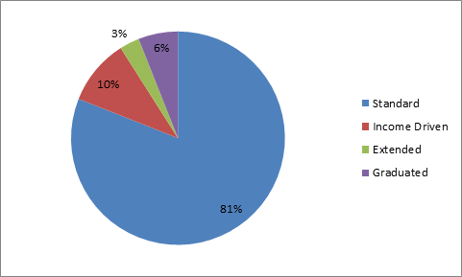
Payment Plan Participation Rates – Great Lakes

Slide 15
Payment
Plan
Participation
Rates
Repayment Plan Participation
Nelnet
1%
7%
5%
Standard
Income Driven
Extended
Graduated
87%

Slide 16
Some
Examples
•
Francy from Florida
–
–
–
–
–
Single with no dependents
Starting salary of $35,000
Borrowed $50,000 to get her
degree in art
$23,000 in Subsidized; $27,000 Unsubsidized
Interest rates were 6.8% on all loans in repayment in this example.

Slide 17
Francy’s
Experience
in
ICR
•
•
•
•
•
Monthly payment $392
Final payment $525
Repaid in 168 months (14 years) Not eligible for loan forgiveness Total Payments $79,244

Slide 18
Francy’s
Experience
in
IBR
•
•
•
Monthly payment $228
Final payment $575
Repaid in 236 months (19 years, months)
8
•
•
•
Not eligible for loan forgiveness (< 25 yrs.)
Eligible for subsidized interest of $1,418
Total Payments $99,574

Slide 19
Francy’s
Experience
in
PAYE
•
•
•
•
•
•
Monthly payment $152
Final payment $492
Repayment capped at 240
months
Receives $1,999 interest subsidy
Total payments $70,710
Amount forgiven $44,360
/
year

Slide 20
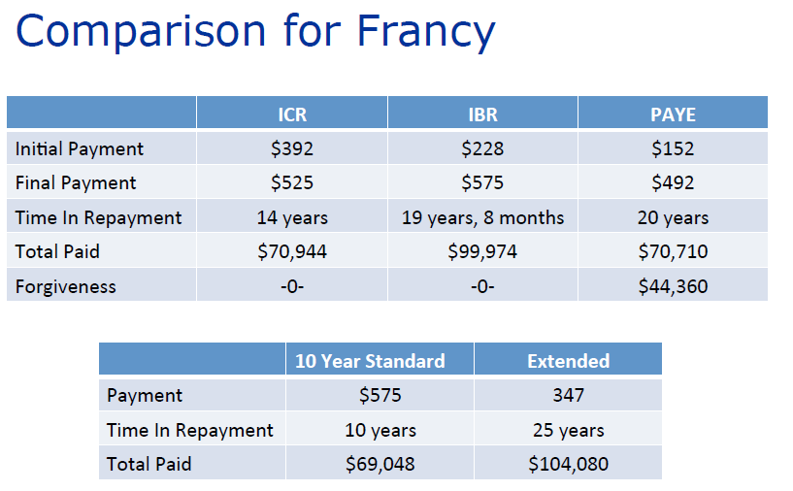

Slide 21
High Debt – High Income Example
•
Dilip the Doctor
Single with no dependents
Borrowed $125,000 for a degree in medicine
$24,500 Subsidized; $100,500 Unsubsidized
Starting salary of $70,000
Interest rate was 6.8% on all loans for this example

Slide 23
Average
Debt
–
High
Income
•
Emma the Engineer
–
–
Single with no dependents
Borrowed $27,000 for a degree in Civil
Engineering
–
–
–
$24,500 subsidized; $2,500
Starting salary is $65,000
Interest rate is 6.8%
unsubsidized

Slide 24
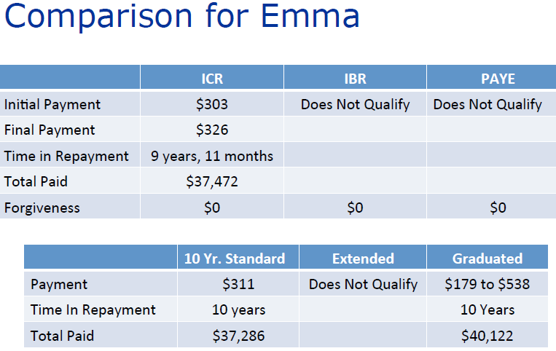

Slide 25
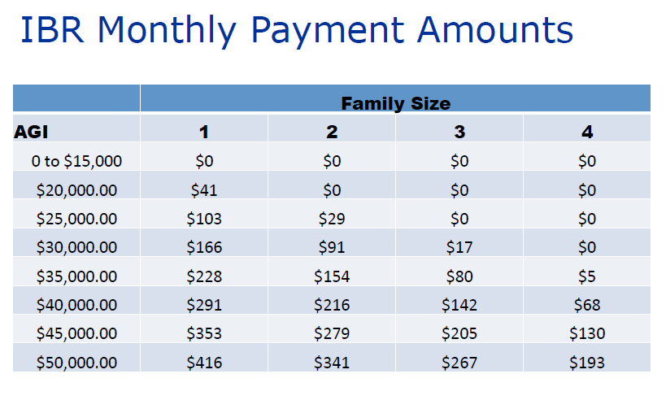

Slide 26
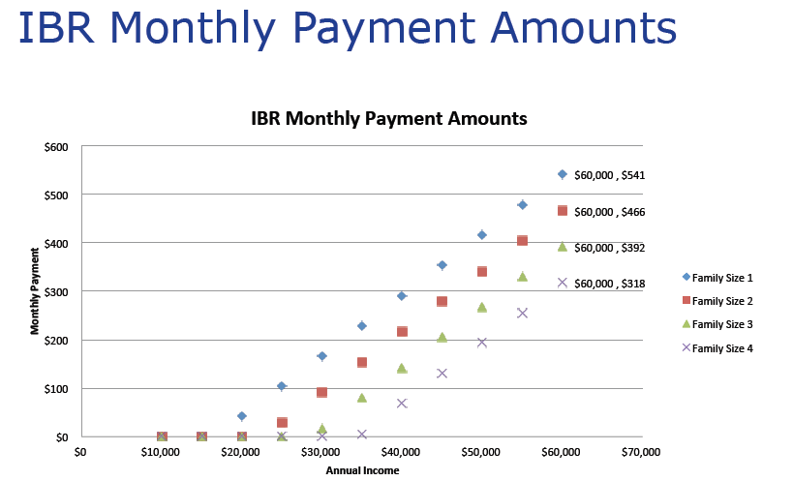

Slide 27
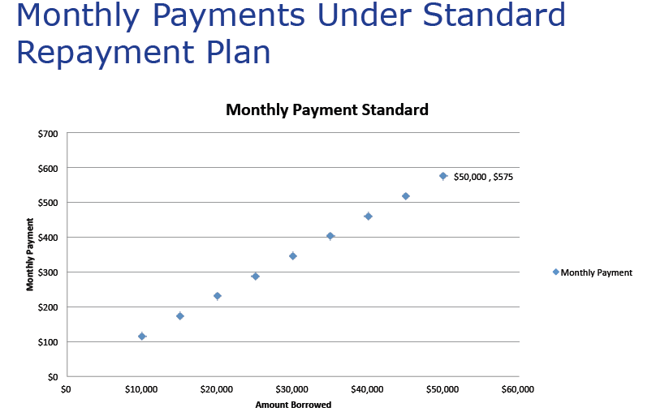

Slide 28
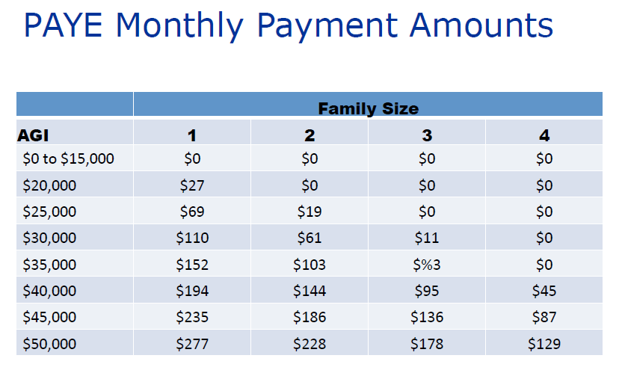

Slide 29
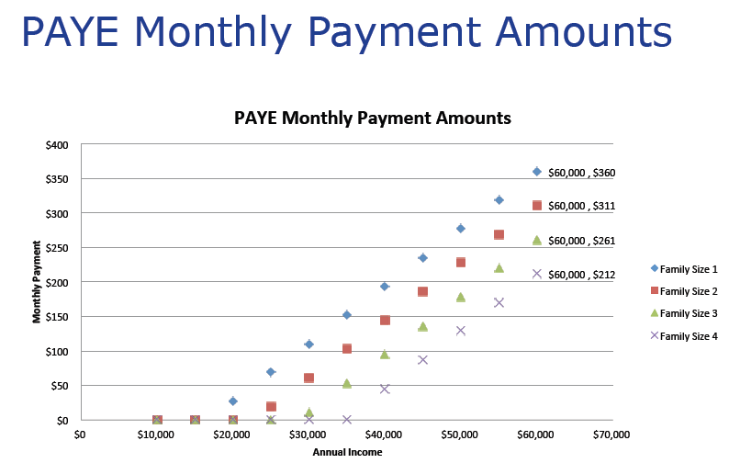

Slide 30
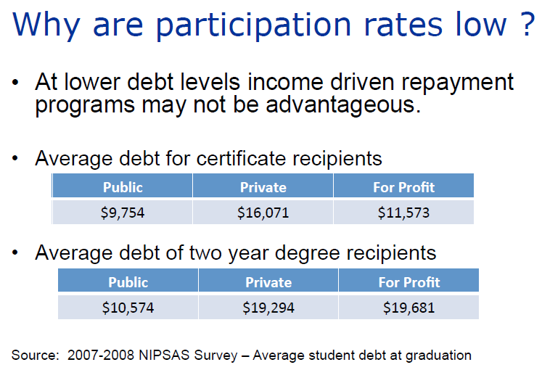

Slide 31
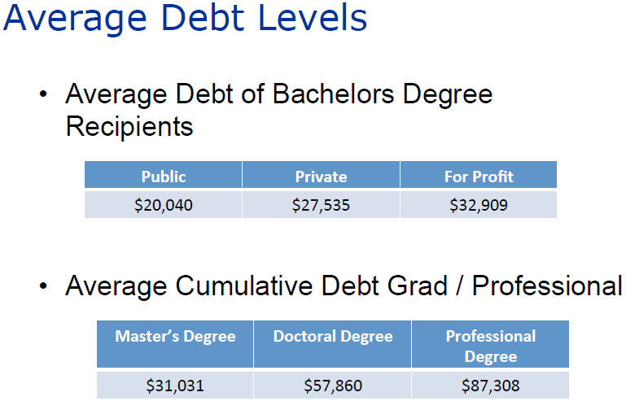

Slide 32
Why
are
participation
rates
low
?
•
Borrowers don’t take time to submit
qualifying information
Want to retire debt faster
Anticipate incomes rising quickly
•
•
•
Income driven repayment plans can be
complicated to understand
Loan repayment is intimidating for many
borrowers and they fail to investigate their
options
•

Slide 33
Who do we want to participate ?
•
Borrowers struggling in repayment due to low income
Borrowers with debt levels high enough to benefit
Borrowers who can benefit from low monthly payments
Borrowers who may be eligible for Public Service Loan Forgiveness
•
•
•

Slide 34
Why
should we
care
?
•
Complexity is a disincentive to
participation
Borrowers need to be educated to take advantage of these plans
Increased participation could affect default rates
Potential to increase participation in desirable but low paying professions
•
•
•

Slide 35
Why
should
we
care
?
•
•
Creates a safety net for borrowers
As borrowing increases these
repayment options become appropriate for more borrowers
•
Borrowers should take
of loan cancellation benefit
advantage

Slide 36
Servicer
Experience
•
•
Application on-line has increased interest
Ability to access income verification data
(IRS Retrieval)has increased participation
•
Annual income recertification
problem
Complexity of the program is participation
remains a
•
a barrier to

Slide 37
Resources
•
Available from FSA
Repayment plan information and calculators
at http://studentaid.ed.gov/repay-loans
Loan counseling information, calculators and budgeting advice at http://StudentLoans.gov
Flyers about specific repayment options at:
➢➢ http://studentaid.ed.gov/sites/default/files/income- based-repayment.pdf
➢➢ http://studentaid.ed.gov/sites/default/files/pay-as- you-earn.pdf

Slide 38
Resources
•
From Federal Loan Servicers
–
Compare repayment plans at
www.studentloans.gov
➢➢ http://www.nelnet.com/Lower-payments/
➢➢ https://www.mygreatlakes.org/borrower/fiq/
repayment-step2decide.html
➢➢ Complete list of servicer web sites at:
– http://ifap.ed.gov/ifap/
helpContactInformationDetailedList.jsp?lsc=2

Slide 39
Questions

Slide 40
Contact Information
Jon Potter, Regional Director, Nelnet jon.potter@nelnet.net
Sun Ow, Senior Marketing Associate, Great Lakes
sun.ow@greatlakes.org
Jamal Collins, Assoc. Director, UC Berkeley School of Law
jamal.collins@ucb.edu

